Slide 1
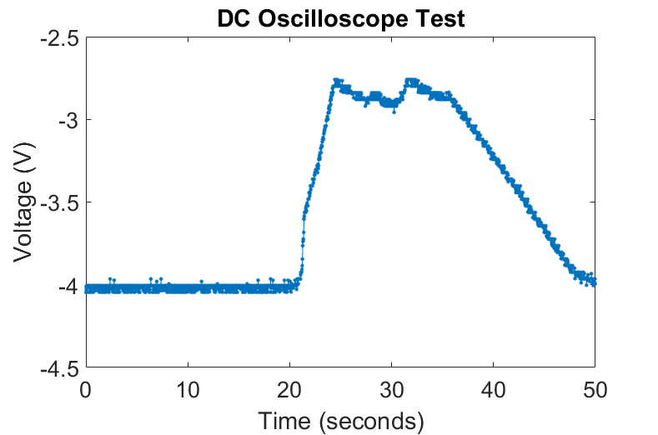




$$V_{G}=0 V$$
$$V_{S}=200 mV$$
$$V_{G}=20 V$$
$$V_{G}<20 V$$

